Slide 1









2025 highlights
Academic inventions – from science to market
47
21
16
New Leads
Patents filed
Finalized licenses and contract
Venture funding & support
3
4
Spin-out companies
formed
Investments made
Exits realized
Utrecht Holdings Impact 2025

Slide 2
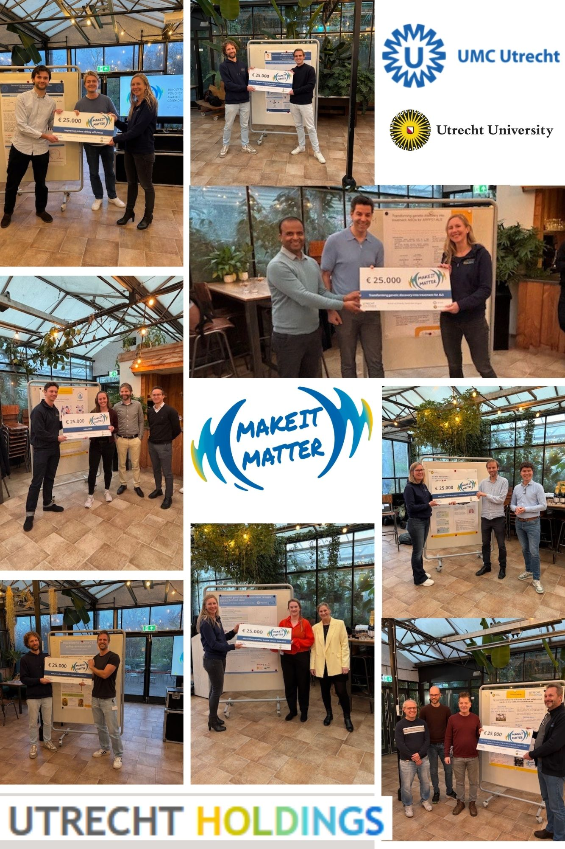

Awarded 8 promising projects with a 25,000 voucher!
.
Introduction of the winning vouchers:
Voucher 1
MicroRNA panel for breast cancer detection
By Cathy Moelans, Paul van Diest en Elsken van der Wall
Voucher 2
Improving prime deiting efficiency
By Paul Schurmann, Stij van Breda Vriesman en Sabine Fuchs
Voucher 3
Transforming genetic discovery into treatment for ALS
By Wouter van Rheenen en Vamshidhar Vangoor
Voucher 4
New powerful astatine-211 radiopharmaceuticals
By Berend van der Wildt en Alex Poot
Voucher 5
A new diagnostic modality for angina with non-obstructive coronary arteries
By Tim Sakkers, Hester den Ruijter en Ernest Diez Benavante
Voucher 6
U-WorkWell
By Iris Beerepoot, Hajo Reijers en Thomas Martens
Voucher 7
Antifungal volatiles te treat human fungal infections
By Robert_jan Bleichrodt
Voucher 8
The Bactericidal combination of D-amino acids and antimicrobial peptides to treat antibiotic resistant bacteria
By Edwin Velhuizen en Marc Wosten
Utrecht Holdings Impact 2025

Slide 3






.
Licensing…..
CryoCloud raises 2 M. in Seed Round
Licentie CoPiloot
Licentie Lumox
Licentie TS Vascular
Licentie ArgenX
?e
Cordys Analytics is now MDR & ISO 13485 certified
…. and venturebuilding
SentryX presents first Clinical Results
Targed secures 21,5 M. Series A Extension
AMT Medical secures 25 M. in Series B Funding to revolutionize Coronary Artery Bypass Surgery
1200 students were placed by Topselect at UU and other institutions.
Utrecht Holdings Impact 2025

Slide 4
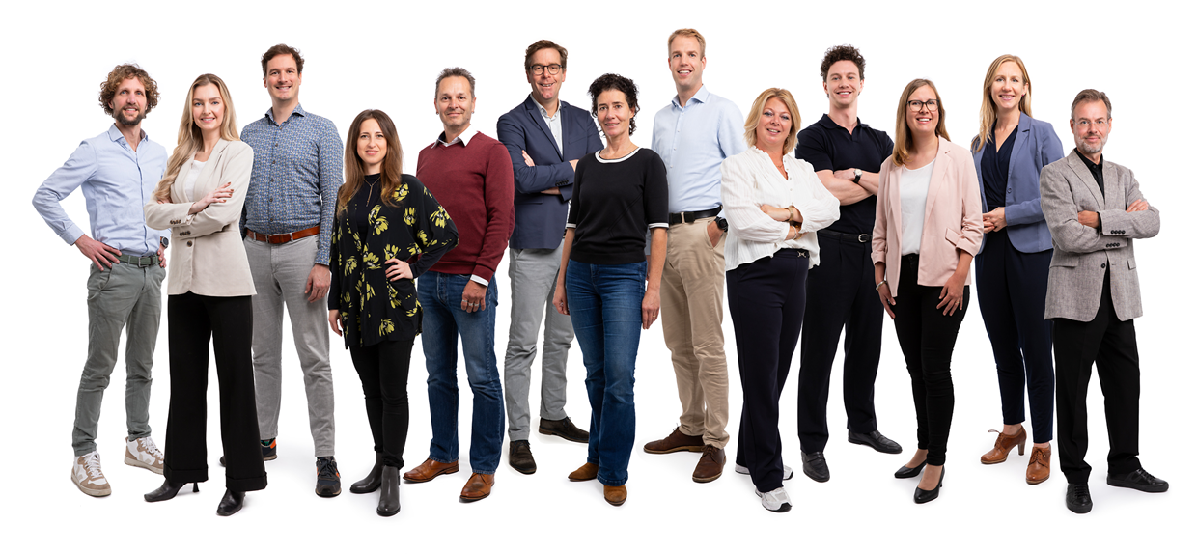


And also..
We launched a new marketing campaign: Make it Matter
UCANACT won the Ureka Megachallenge
NeuroNova TX was winner Venture Challenge spring 2025
TrustHub and UCANACT got a TTT-AI voucher
Utrecht Holdings now is a part of the consortium TTT Greentech
Francoise Dekker and Tim Sakkers, joined the Faculty of Impact
Three new spin-offs have been formed: UCANACT, Artheroscreen and Lumox
And many more…
And we support all of that with this fantastic team!
Utrecht Holdings Impact 2025

